Slide 1


ADVANCE JAVA PPROJECT ONLINE VOTING SYSTEM
Project TEAm members :-
1.Bhushan patil
2.Akshay Mahajan
3.Adresh chauhan

Slide 2
-: SCENARIO :-
1.In this project, we have tried to develop a online voting system portal. In this,voter can able to vote online for the elections. There is no need to go out for voting.
2.Here, we have developed some steps for voting such as voter has to register for voting first, then only registered voter will be able to vote. Without registration no one can able to vote.
3.Voter should remember his username and voter card number during voting.
4. This voting system helps each and every voter for giving their vote to particular party or candidate.

Slide 3
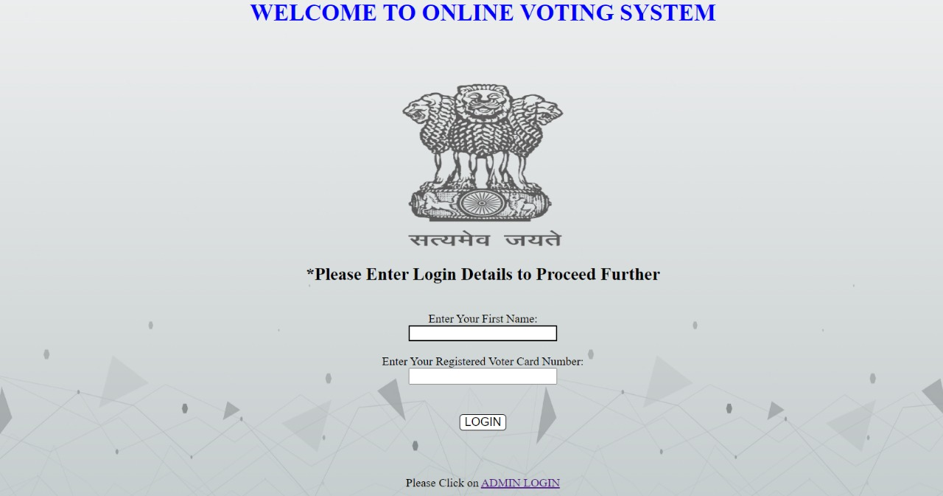
VOTER REGISRATION AND VOTER LOGIN

Slide 4
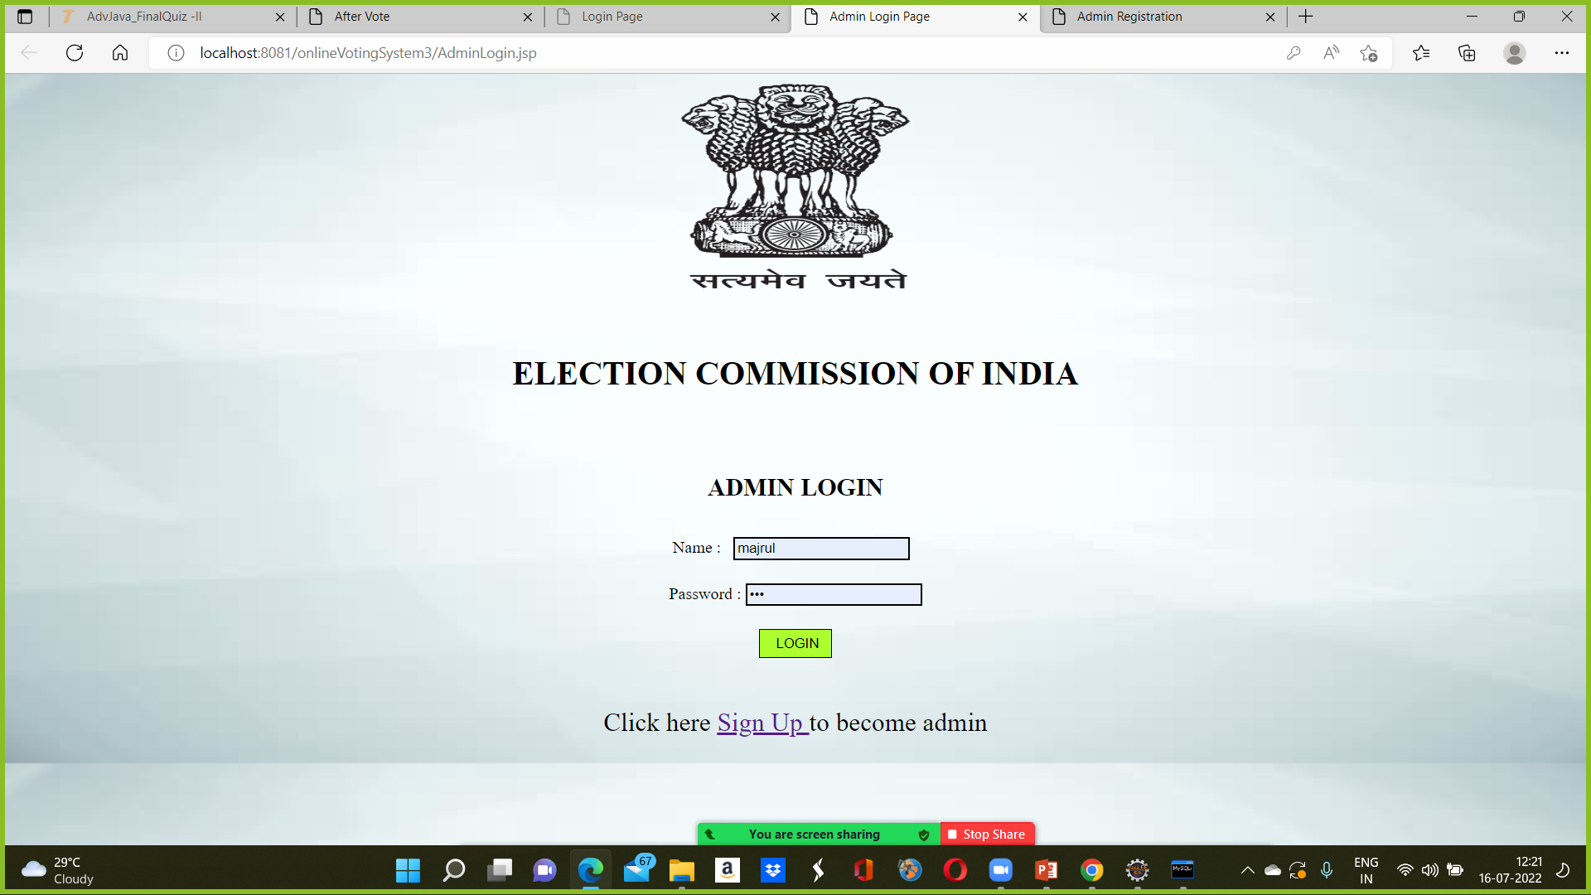
ADMIN LOGIN

Slide 5
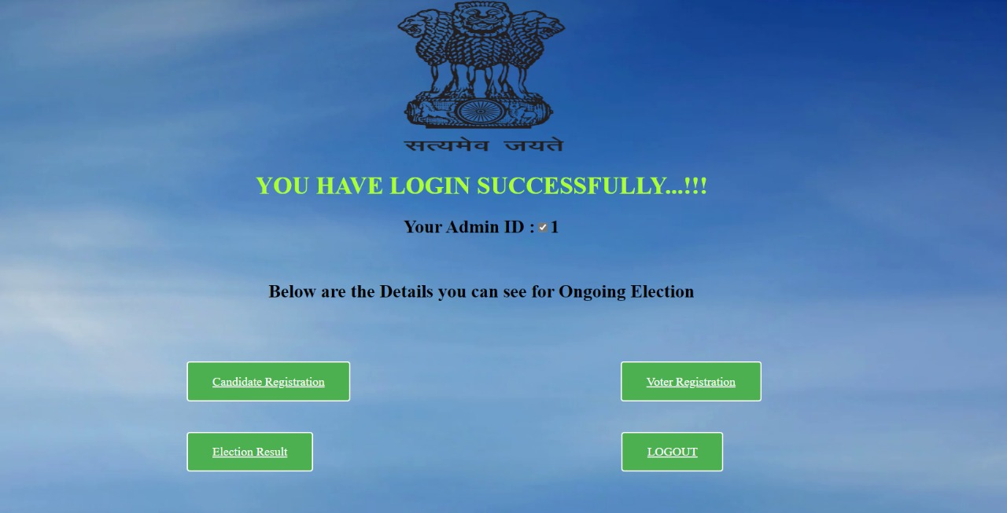
ADMIN INTERFACE

Slide 6
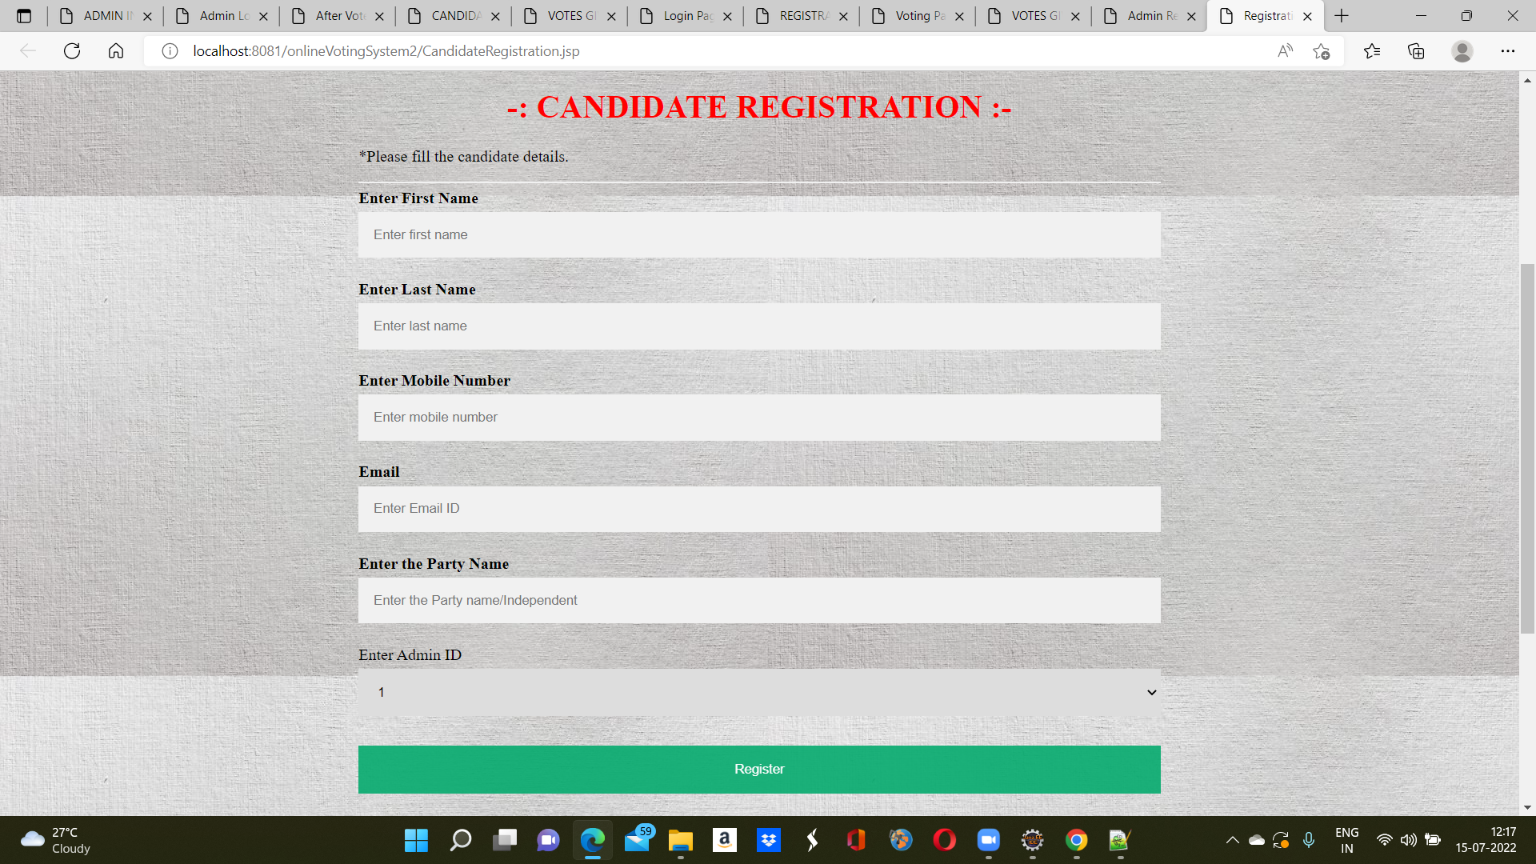
CANDIDATE REGISTRATION

Slide 7
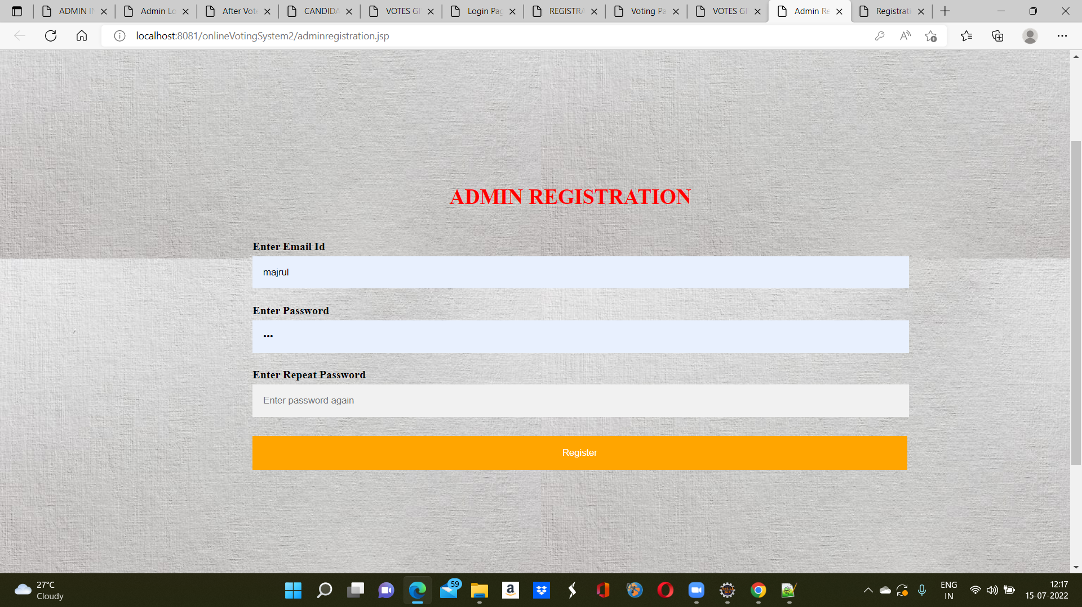
ADMIN REGISTRATION

Slide 8
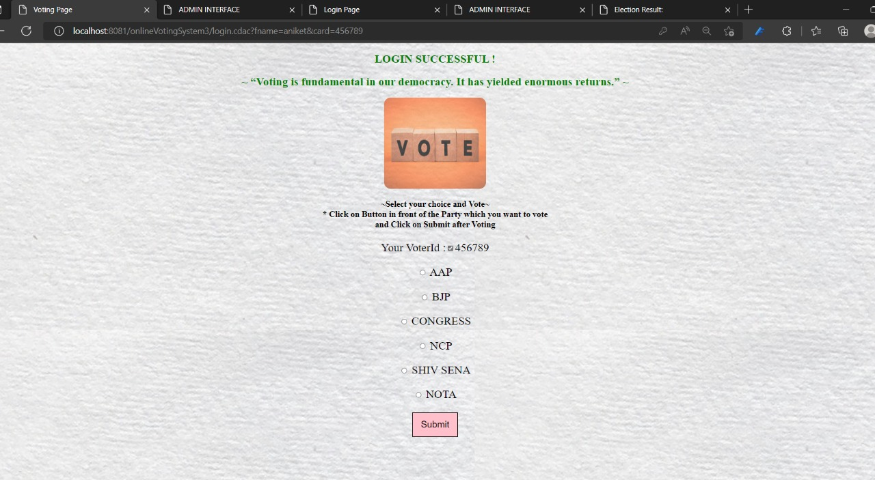
VOTING PAGE

Slide 9
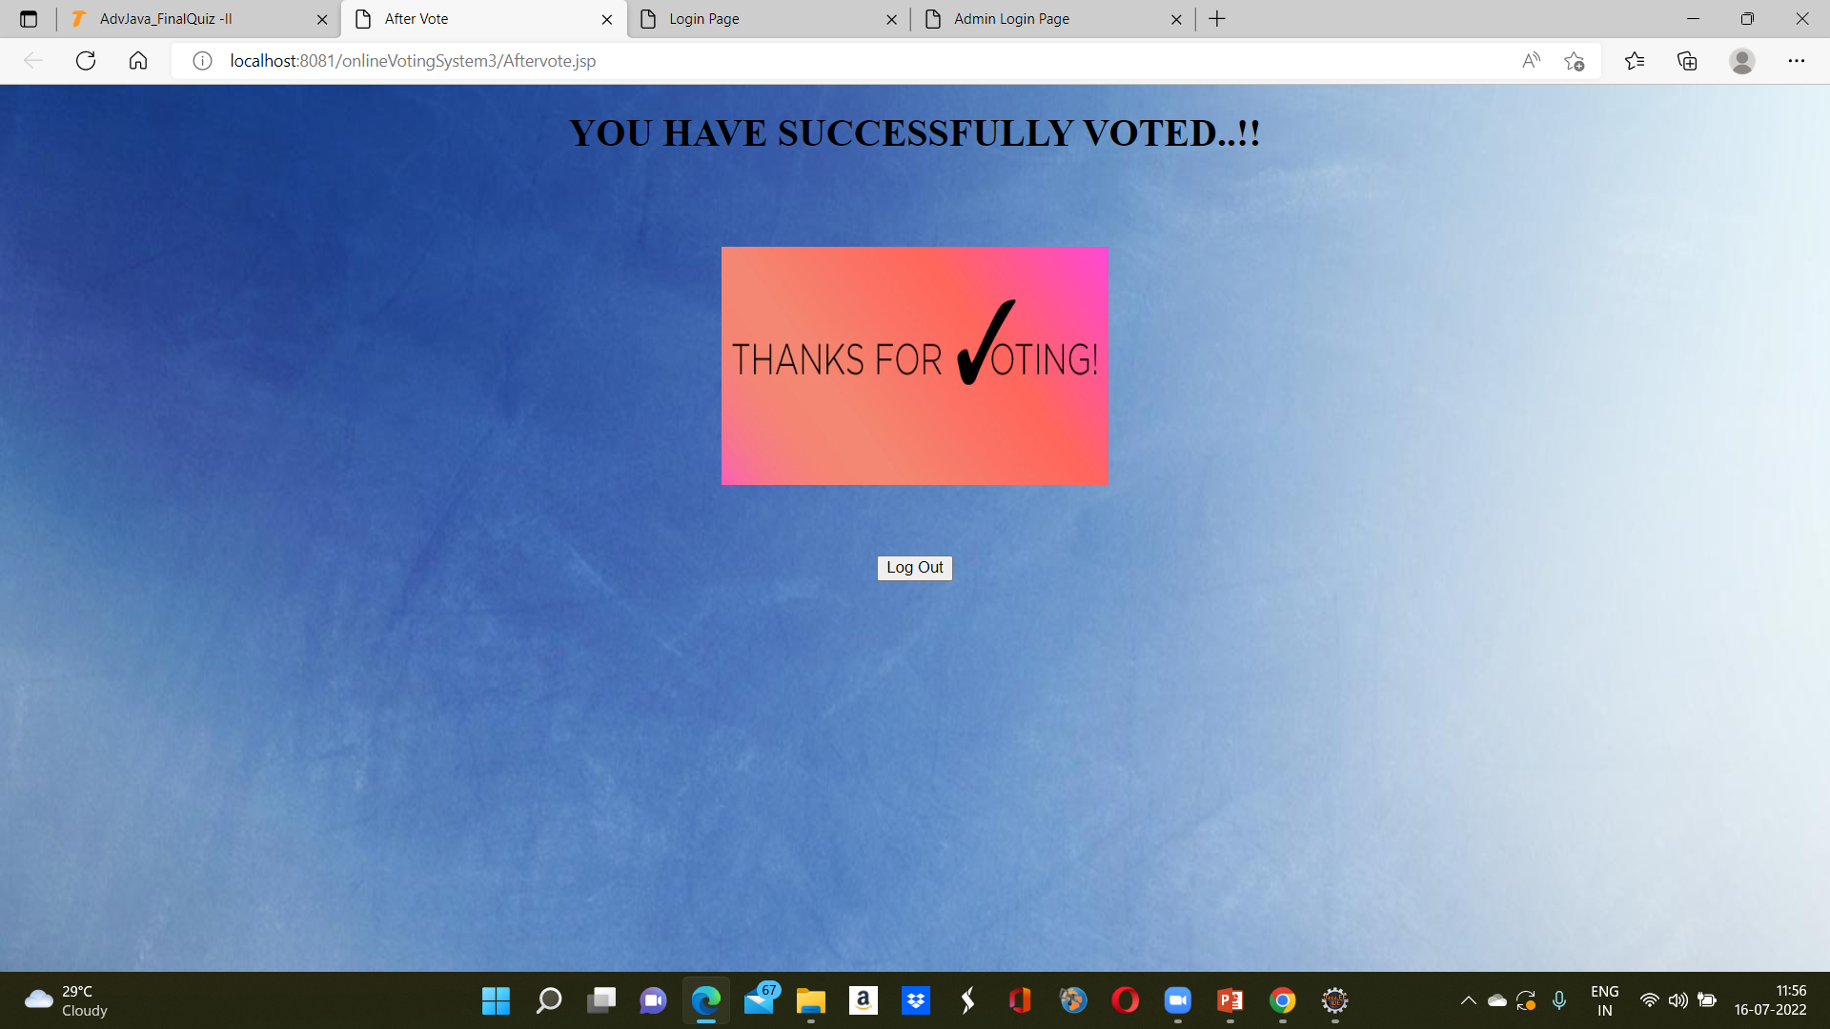
AFTER VOTING

Slide 10
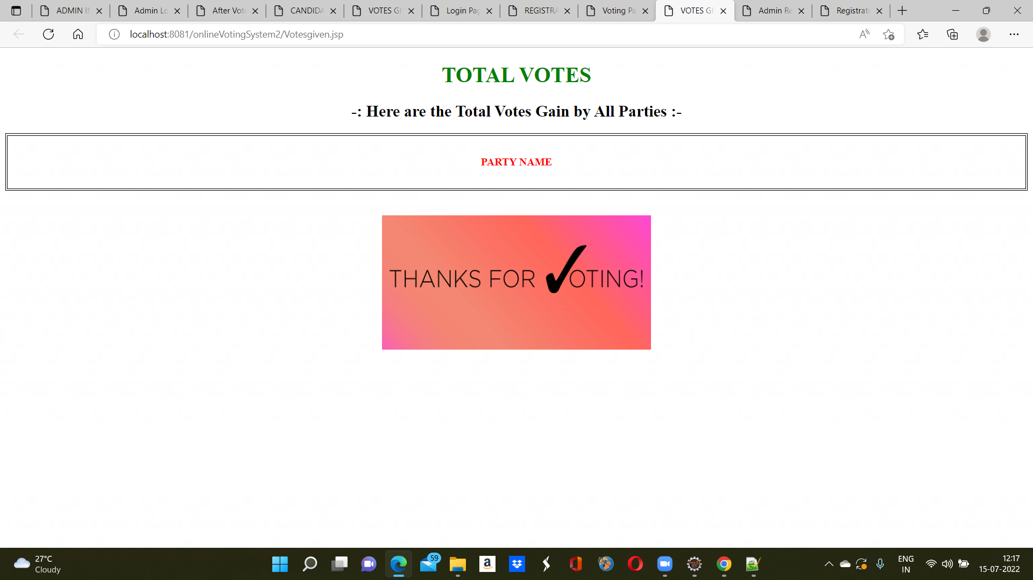
VOTE COUNT

Slide 11
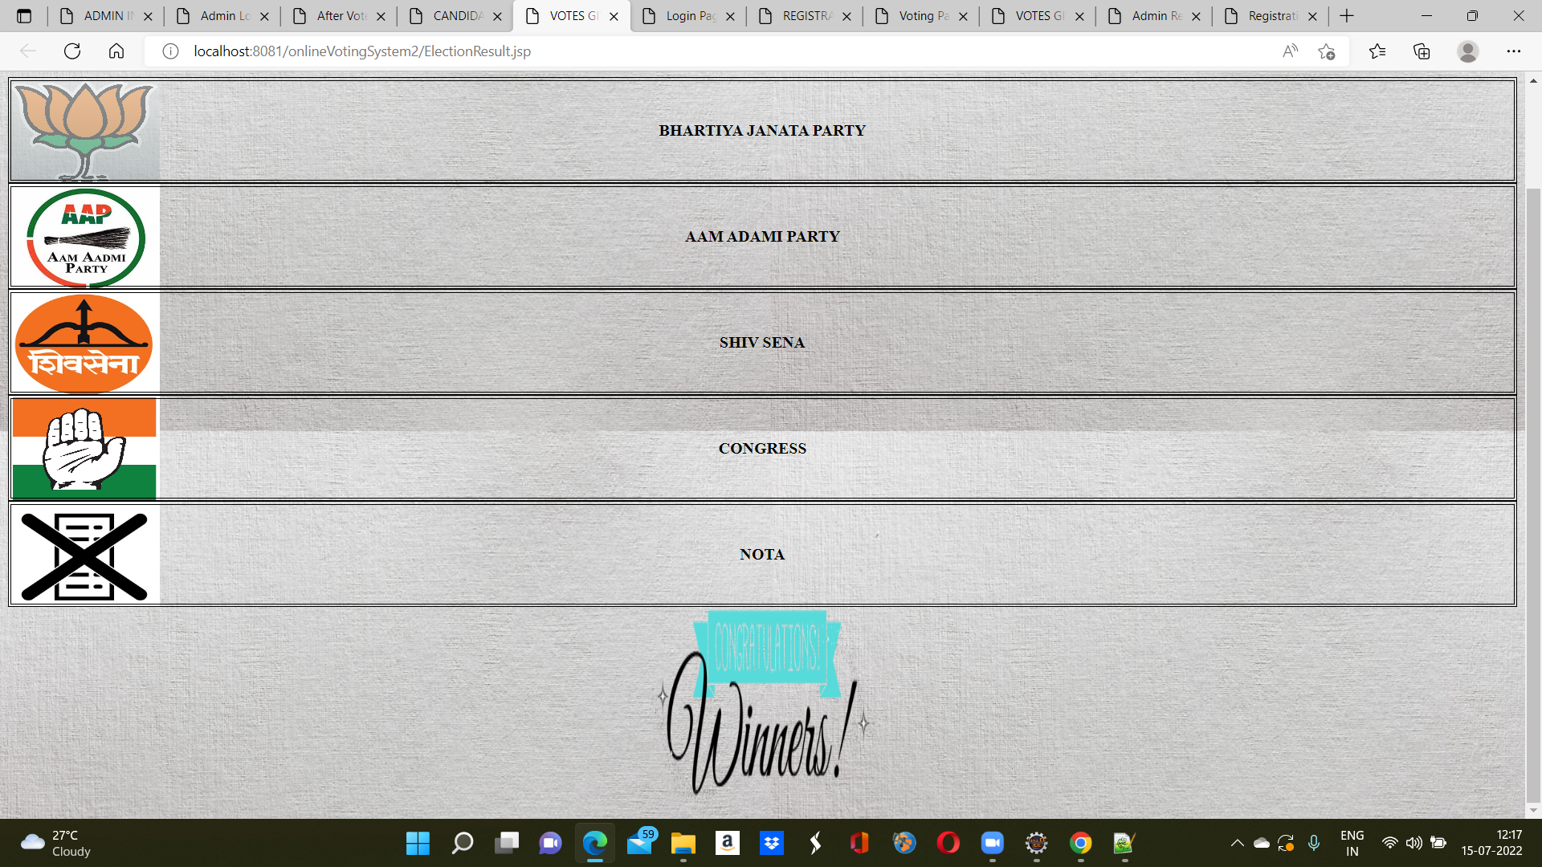
PARTY AND IT’S VOTE COUNT

Slide 12


